Slide 1


Slide 2

PROBLEM STATEMENT
Detecting fraud in Capital One's transaction data is crucial for financial security. The task is challenging due to a highly imbalanced dataset, where fraud instances are rare. The goal is to develop machine learning models that accurately detect fraud while minimizing false positives. This ensures the safety of transactions, protecting both the institution and its customers from potential financial losses.

Slide 3
TRANSACTION FRAUD DETECTION
ABSTRACT
This project explores fraud detection using a highly imbalanced dataset from Capital One. Through thorough data cleaning and analysis, we identified patterns and anomalies. Employing advanced machine learning algorithms, including XGBoost, Gradient Boost, Random Forest, and Neural Network, we addressed challenges posed by dataset imbalance. Despite complexities, these algorithms effectively identified fraudulent activities. By evaluating performance and predictive capabilities, we gained insights into fraud detection methodologies. Additionally, we created dashboards using Tableau for visualization and analysis. This underscores the importance of machine learning in fraud detection, with potential applications across industries. The findings contribute to enhancing fraud detection systems and offer a framework for addressing imbalanced datasets in anomaly detection.

Slide 4

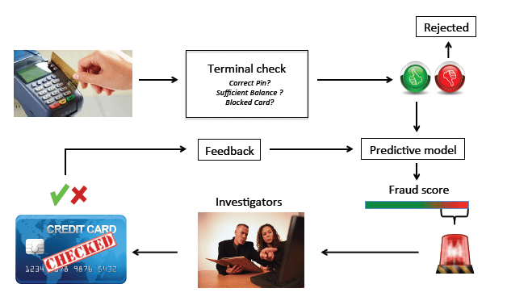

Slide 5

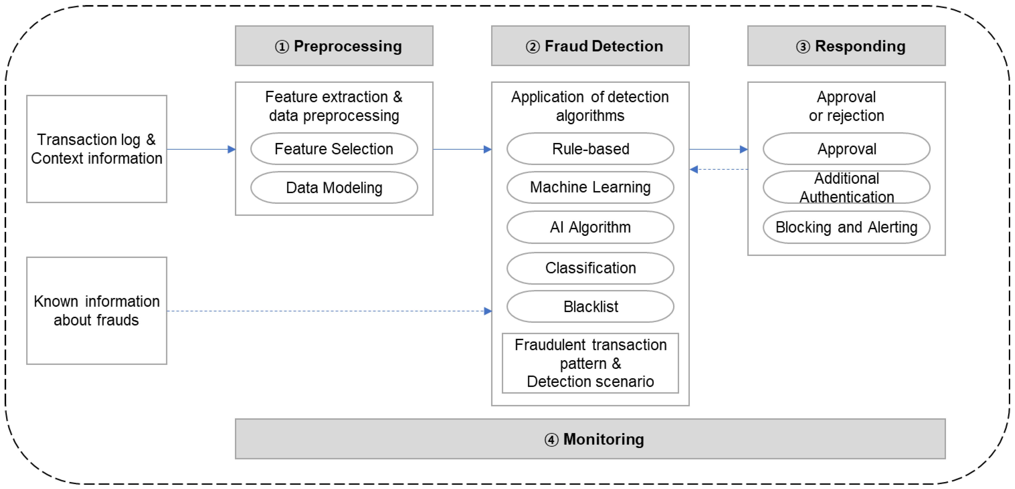
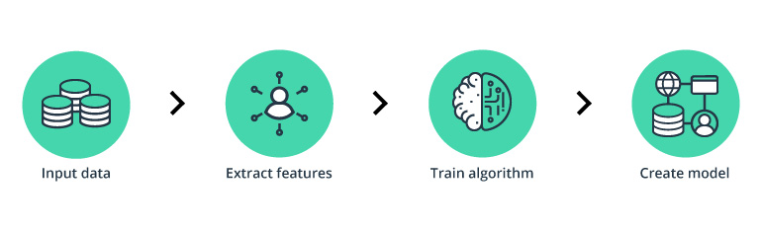

Slide 6
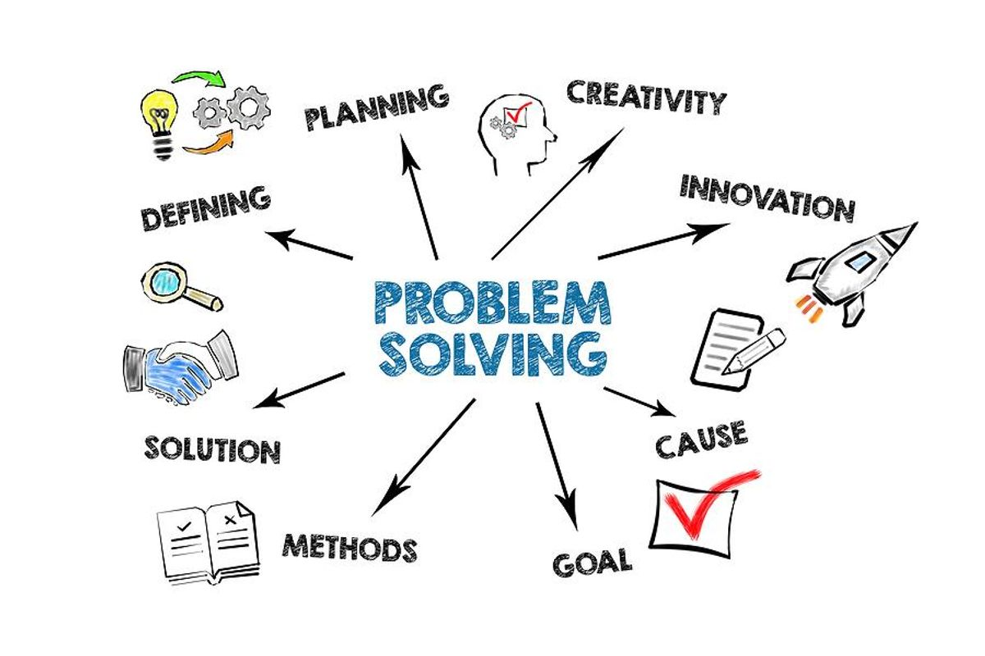

Slide 7


The dataset originates from Capital One, secured during an internship, and serves as a real-time resource for addressing specific tasks. Not publicly available online, it offers unique insights and challenges, contributing to the learning and problem-solving objectives of the internship program.

Slide 8
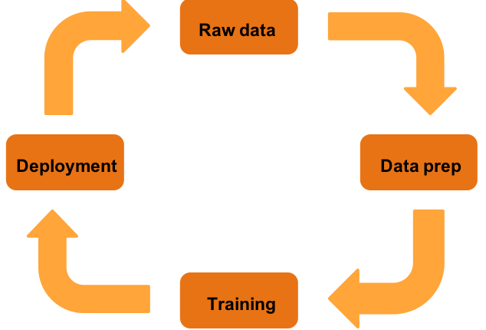

Slide 9
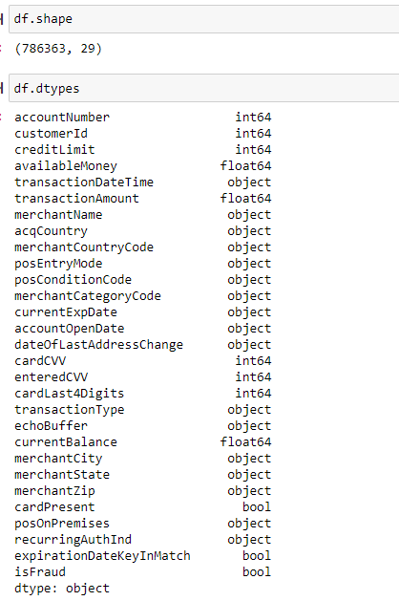


Slide 10

DATA CLEANING

Slide 11
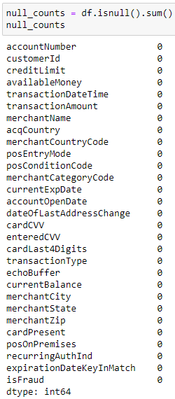


Slide 12
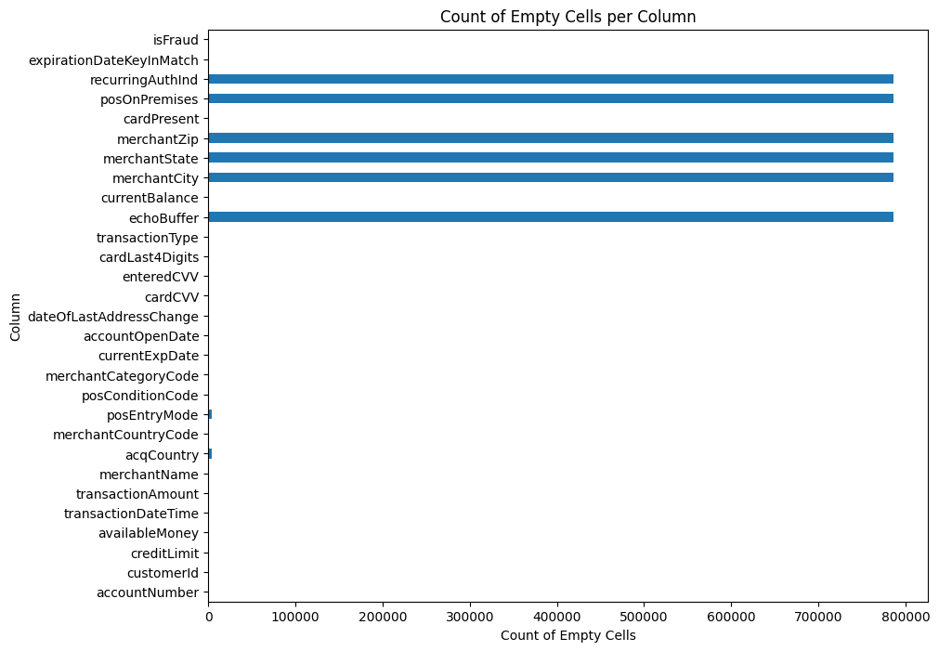

Slide 13


Slide 14
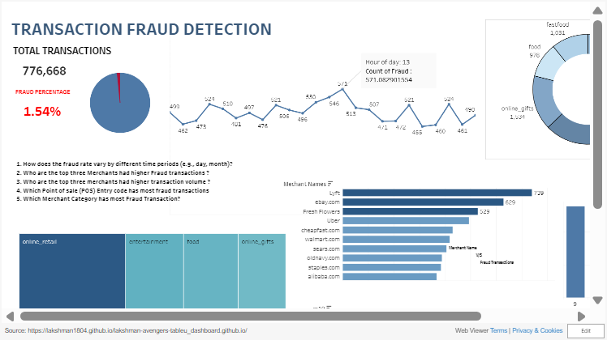

Slide 15
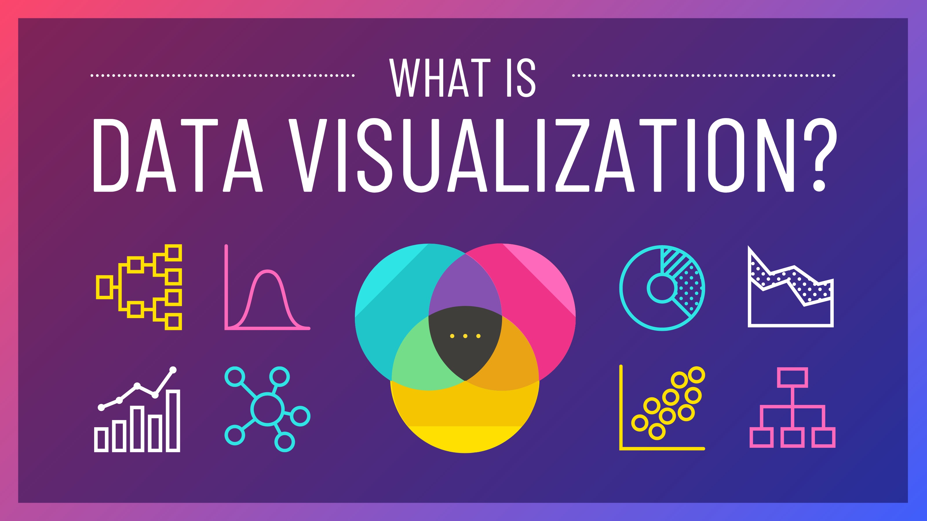

Slide 16
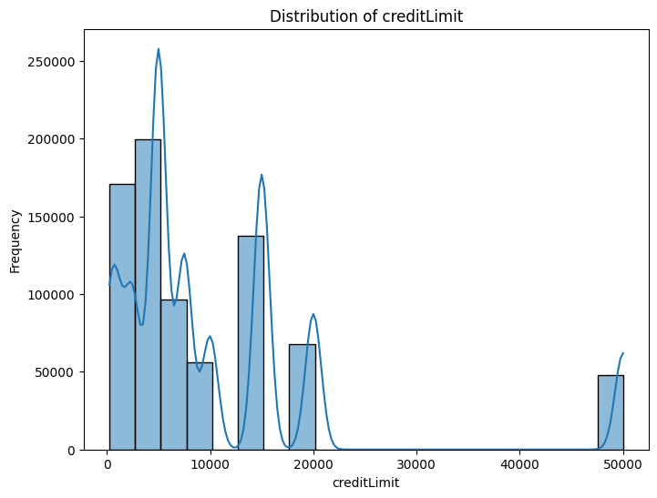
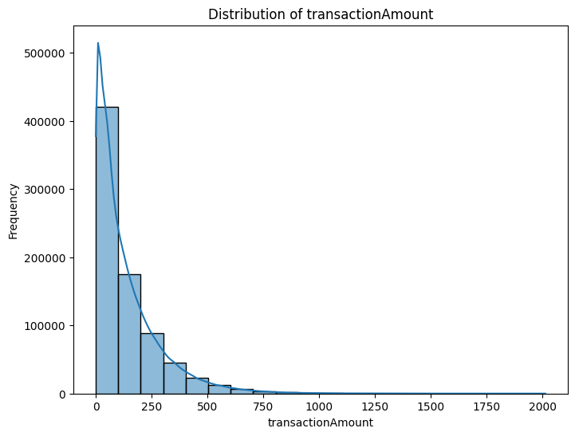
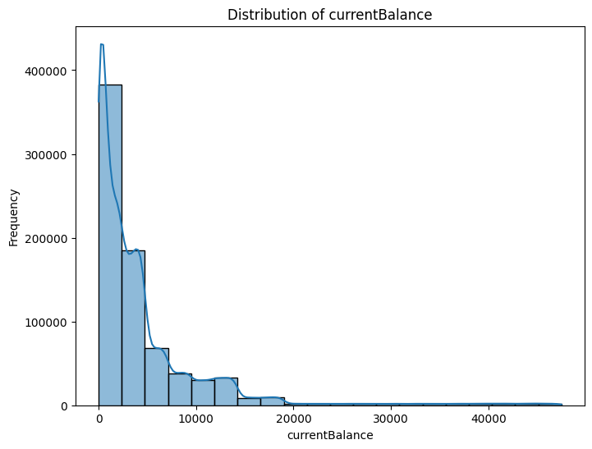
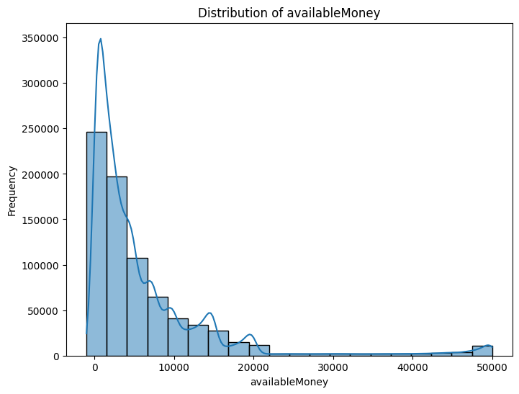

Slide 17
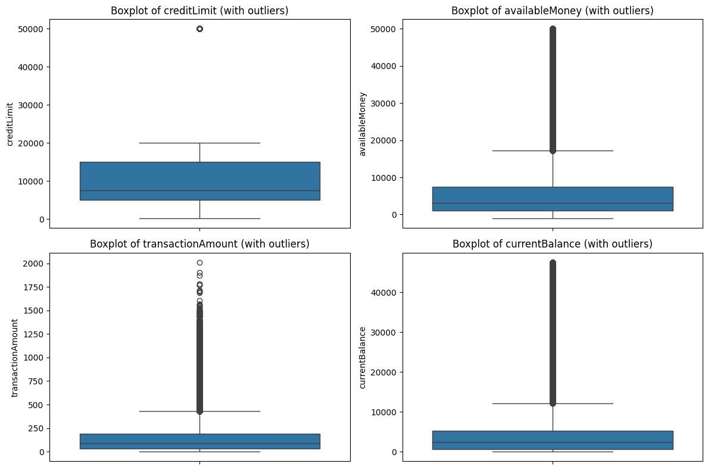
WITH OUTLIERS

Slide 18
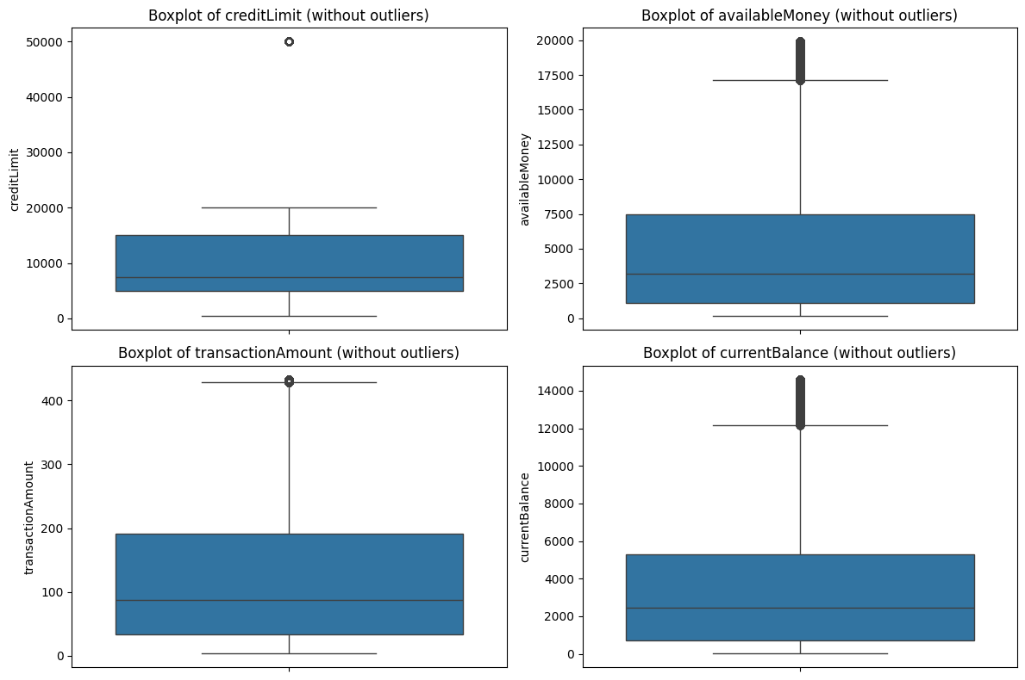
WITHOUT OUTLIERS
Winsorizing is a statistical technique used to mitigate the influence of extreme values (outliers) in a dataset by replacing those extreme values with less extreme values. This approach helps to reduce the impact of outliers on statistical analyses while preserving the overall distribution of the data.

Slide 19
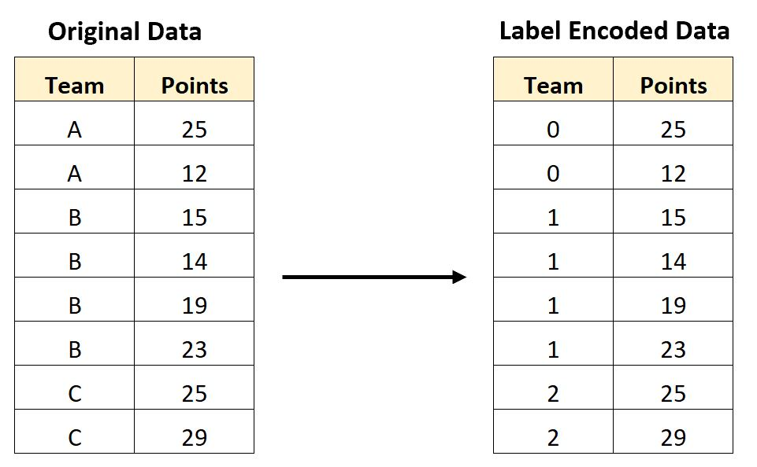
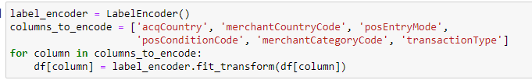
ENCODING

Slide 20
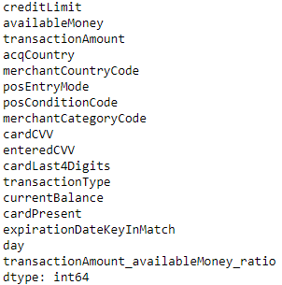
FINAL CONSIDERATION

Slide 21
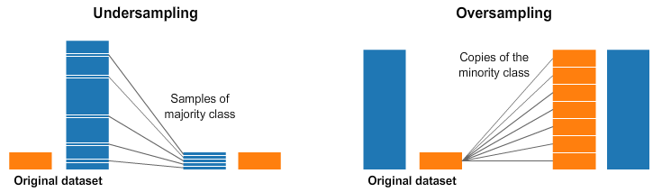
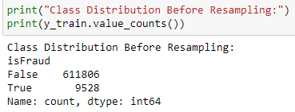
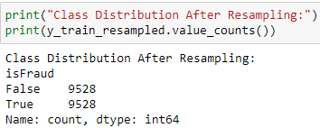
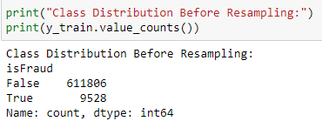
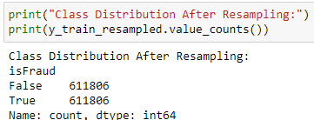

Slide 22
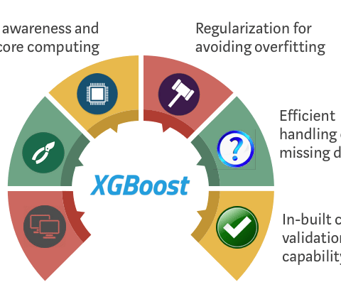
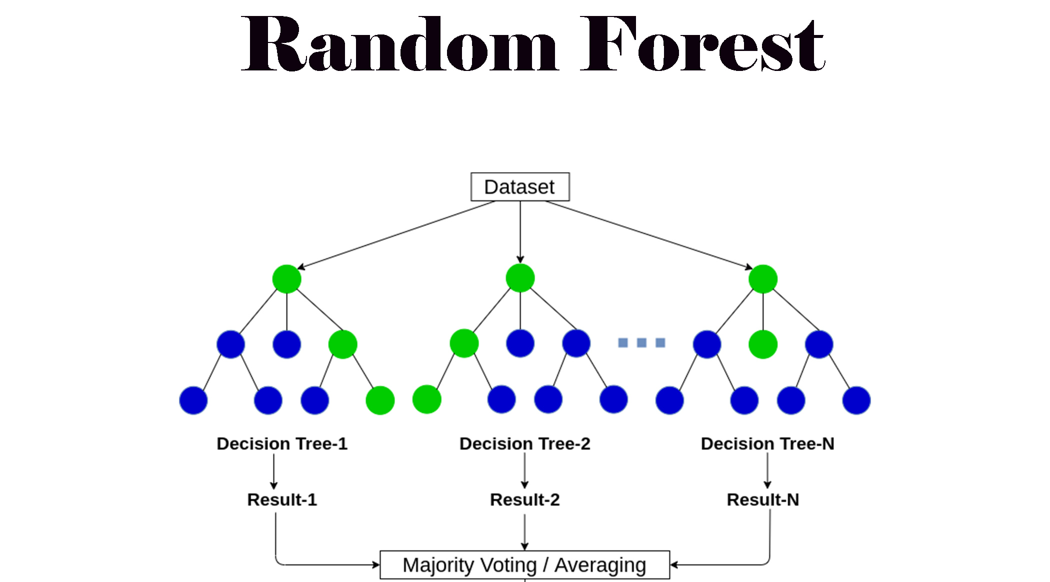
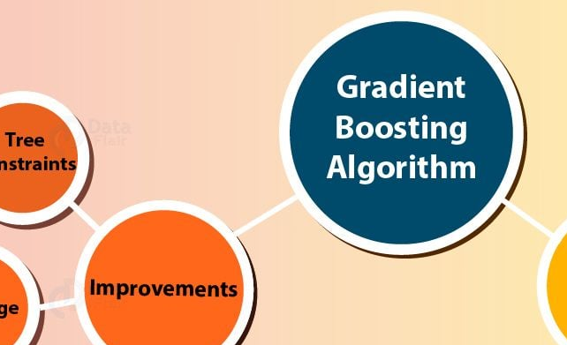

Slide 23

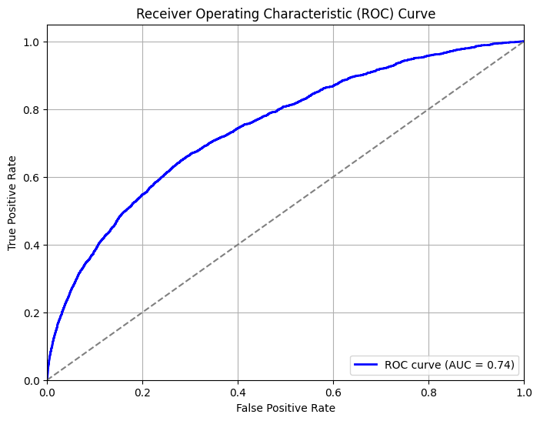
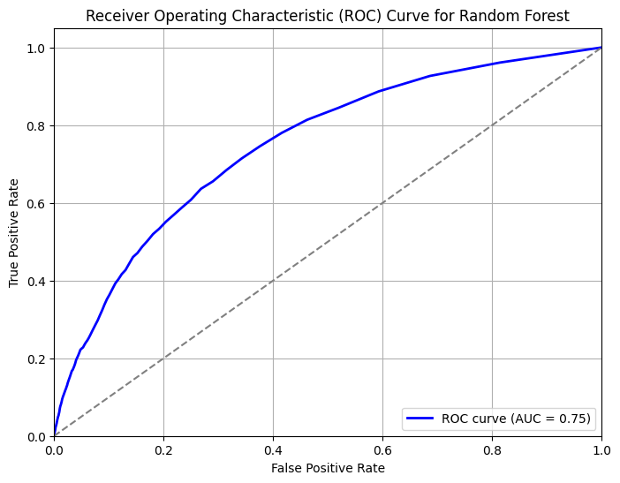
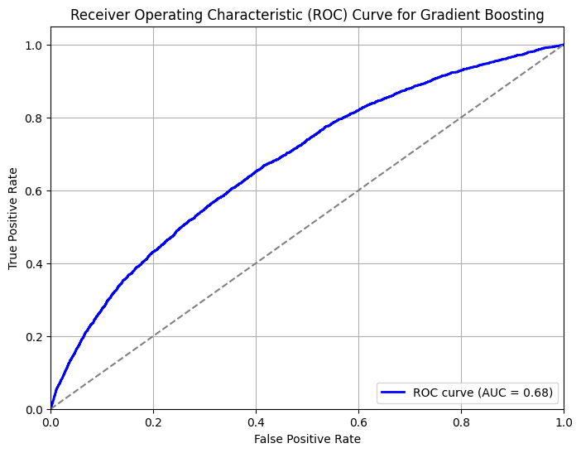
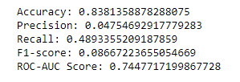
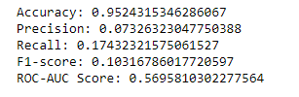

OVER-SAMPLING
XG-BOOST
RANDOM FOREST
GRADIENT BOOST

Slide 24
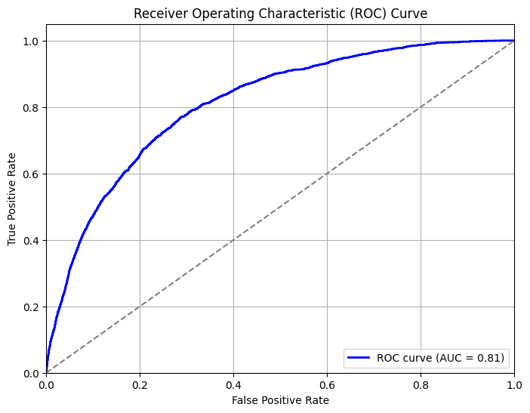
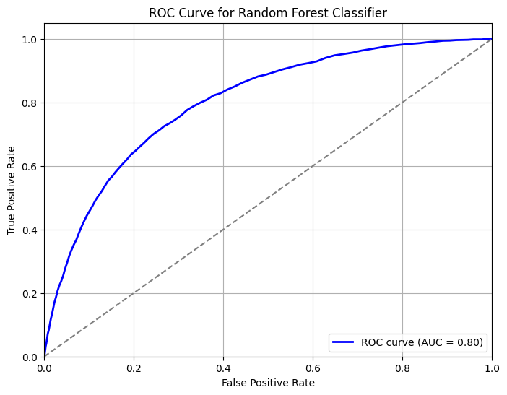
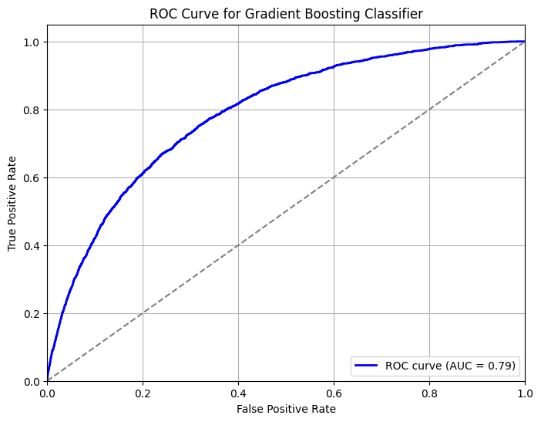



UNDER-SAMPLING
XG-BOOST
RANDOM FOREST
GRADIENT BOOST

Slide 25
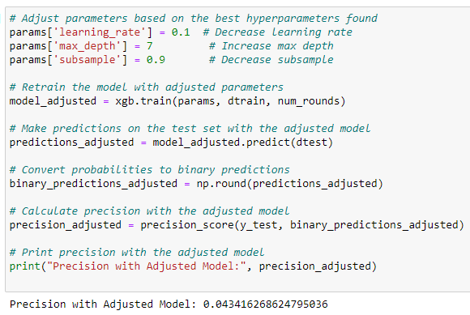
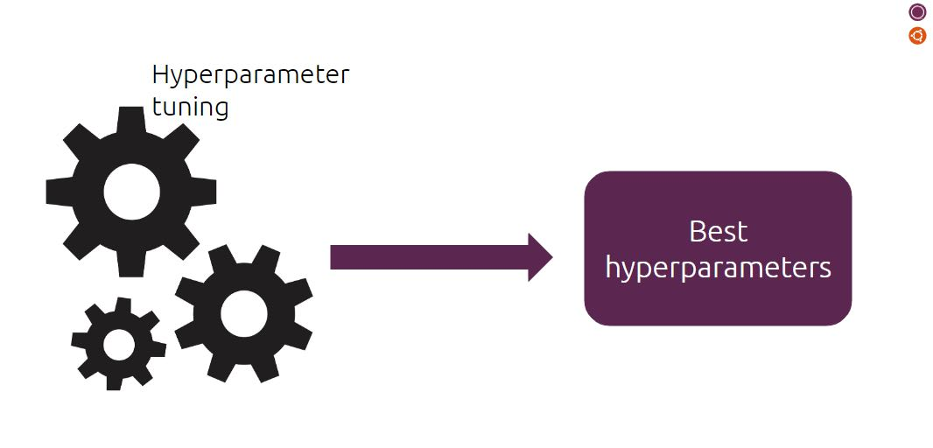

Slide 26

Add extra features using feature engineering.
Add more data for transactions which are fraud.
Use other methodologies by not only limited to machine learning.
Consider adding up multiple algorithm approach for predictions.

Slide 27

Dataset issues.
Threw up null values when implementation.
Realtime experience.
Vast Implementation.

Slide 28


